Slide 1
BUILDING BROADBAND INFRASTRUCTURE, ONE BUILDING AT A TIME
Notes:
Is the 1st “building” used as a verb or noun?
Verb: “Creating Broadband Infrastructure”
If a verb, clever word play
If a noun, it’s repetitive
Change to: “Broadband Infrastructure: One Building at a Time”

Slide 2
The following is intended to outline Aditum’s general product direction. It is intended for information purposes only, and may not be incorporated into any contract.
Notes:
“Our lawyers wanted to say, ‘hello’…”

Slide 3
WHAT DOES ADITUM DO?
Property NOI
Provides a luxury amenity property
Is “Turn-key”
Has Proven ROI
Greater building operation control
Every building & tenant needs internet
LANDLORD
TENANTS
Notes:
NOI = Net Operating Income
NOI is (typically) calculated on an annual basis. So, here’s an example of how to calculate NOI out in the wild.
Imagine you are evaluating a potential investment property: a small, four-unit apartment complex. Each unit rents for $1,500 per month, making the Potential Rental Income (PRI) $72,000 per year. The coin laundry in the basement of the property makes $1,000 annually.
Vacancy losses are 10% (PRI x .10), or $7,200 per year. This brings the Gross Operating Income (GOI) to $64,800. Based on the current owner’s accounting, operating expenses are $15,000 each year.
Net Operating Income = (Gross Operating Income [$64,800]) + (Other Income[$1,000]) - Operating Expenses [$15,000]
Net Operating Income = $50,800 annually
By using Aditum to provide high-speed, reliable Internet and superior customer service to tenants – building owners, developers and property managers are able to provide a luxury amenity while increasing NOI to the property.

Slide 4
NOI, MDU & REVENUE GROWTH

Slide 5
BRIDGING THE DIGITAL DIVIDE
Unsatisfied Tenants = Revenue Loss
Interrupted Internet Connectivity = Unsatisfied Tenants
Inadequate Bandwidth = Interrupted Internet Connectivity
“
Modernizing the delivery of broadband, Aditum is an innovative software platform that increases service agility and operations efficiency for commercial owners, developers and building managers while delivering a framework that enables new revenue streams and structural cost reductions. Aditum offers broadband from an always-on fiber connection, service flexibility with full-service analytics-driven customer support, and a gateway to an endless supply of the fourth utility.
– BROADBAND, states Aditum’s founder & CEO, Brian Higgins
“
Notes:
Change initial paragraph to be short, blunt & impactful.
Issues noted:
Tenant satisfaction
Interruptions to online connectivity
Inadequate bandwidth
Implied impact:
Revenue loss (d/t unhappy tenants)
Solution:
Aditum can prevent potential revenue loss
BRIDGING THE DIGITAL DIVIDE; WHY IT MATTERS
*Thought about presenting this slide at trade show:
Tell a story
Billy Bob is losing revenue from his buildings.
He has tenants who may be leaving his buildings because, now that so many WFH, they’re internet connections are always getting interrupted
His tenants are unhappy which is risking Billy Bob’s revenue…

Slide 6
Internet Sales is one of the few ways to add Net Operating Income
Typical 200 unit residential property can generate roughly $85k/yr in profits for owner
38 Million residential MDU’s nationally, over 9.8 million units in Mid-Large buildings (as of 2015)
Average internet price $70-$75/mo for typical household
Cost to resell internet ranges between $10 and $35/mo per tenant based upon local bandwidth options & building size (bigger=cheaper)
Expected margins of $15-45/mo per tenant, split between landlord and Partner
Number of tenant units per building
REVENUE OPPORTUNITY
http://census.gov General Housing Data - All Housing Units (NATIONAL) 2013 American Housing Survey, revised on February 24, 2015

Slide 7
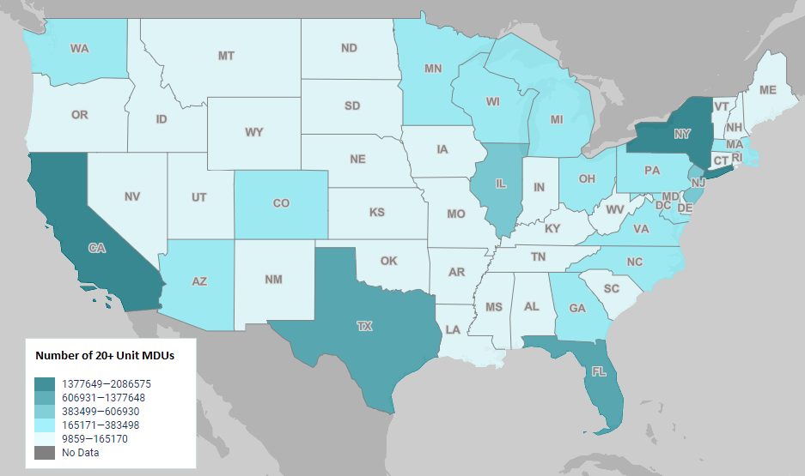
2019 Mid-Large MDU Density & Growth by State
In 2019 an Estimated 13.6M Residential MDU buildings exist with 20+ units in structure
Increase of 3.8M MDU units since 2015 in 20+ unit buildings
20+ unit MDU construction projects represents 60% of all residential housing construction since 2015
Source: census.gov American Community Survey 2019 ACS1-Year Estimates Data Profiles
Number of tenant units per building
REVENUE OPPORTUNITY

Slide 8
NEXT GEN OF BROADBAND DEPLOYMENT
Internet = 4th Utility
Most important to tenants
Provides a lasting ROI
Improves property NOI
Increases property value
Innovative Alternative.
Aditum is a major extension of fiber optics.
REVOLUTIONARY
Aditum’s broadband technology can operate up to Gigabit speeds.
Successful & Proven.
Aditum’s turn-key proven technology and methodology is deployed coast to coast.
Notes:
Aditum is the premiere broadband multi-tenant management platform for all MDU housing and commercial building applications. Internet is the 4th utility, the one tenants care most about, and the only one that gives a lasting return on investment simultaneously improving the NOI of premises while increasing the property value.
Innovative Alternative.
Aditum is a major extension of fiber optics, using next-generation technology, all the way to your residence and business customers’ premises.
REVOLUTIONARY
Aditum’s broadband technology can operate up to Gigabit speeds and is fast enough to spur new business and innovation in MDU housing and commercial buildings
Successful and Proven.
Aditum’s turn-key proven technology and methodology is deployed coast to coast.

Slide 9
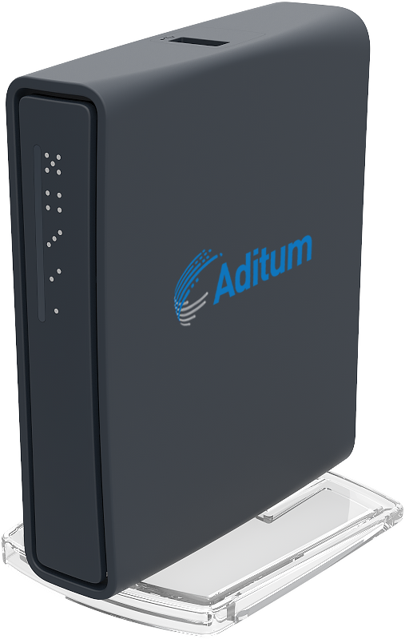
Aditum’s Zero-Touch Router is the Gateway that Allows Premises of Any Size, to Deploy Tenant Broadband Effortlessly
The easiest solution to connect your tenant broadband.
Administrator(s) assigns router to tenant’s account.
Zero Touch router automatically programs itself, assigning unique wireless SSID and password. Plug-in and connect.
Tenant automatically receives customizable welcome letter, along with Wi-Fi information.
ZERO TOUCH
ROUTER
Enables effortless end-user deployments and tenant self installation.
Notes:
In the initial “sales” slides, I’d like to have a visual of what Aditum is physically providing.
I’d need to know more about the dynamics of the sale:
e.g. who pays what, what is purchased, what is shipped, are there any 3rd party (TPA) admins involved, etc
If a prospect says “Yes, I want to do this,” what are the next operational steps to go from a “verbal yes” to that (now) client earning $$$ from saying yes?

Slide 10
WHY CHOOSE ADITUM
Five-nines of Reliability | Provide your tenants with high performance bandwidth | Fiber to the Premises (FTTP) is more reliable than consumer options and has lower latency | Revolutionize your real estate portfolio with Internet speeds up to 10 Gigabit per structure and up to 1 Gigabit per tenant | Provides an easily supported and maintained system with excellent service to each tenant in the community | Just Internet – no outdated TV and landline bundles | Available to commercial and residential real estate, including: MDU/MTU property types - coast to coast.
“
“
Aditum is an excellent choice for multi-tenant buildings, who want to offer a turn-key Internet solution. The software is ideal for providing community-wide, quality, reliable Internet access, while creating an additional profit center for the property.
– Nick Santarsiero, President, Property Protection Consulting
Notes:
“Five-nines of Reliability” Did you mean “AVAILABILITY”? (or was this a marketing tweak on that concept)?
I like the layout of this slide, however I’d like to clean it up (fewer words) & put those shorter bullet points/sentences in ‘text boxes’ under the horizontal gray bar/arrow.
On the surface, five 9s availability may seem like more of a selling point, the kind of thing you highlight to sway potential customers. But it’s much more than a line item in a pros and cons list. High availability is closely tied to business continuity. As a UCaaS company, much of our blog content is dedicated to that topic. Cybersecurity and disaster recovery, cloud resilience and reliability—there are loads of factors that play into business continuity. System uptime is yet another item in that whole sphere. You need high availability to be reliable and strong cybersecurity practices to protect your availability. A single hour of downtime not only decimates your high availability status but can cost a business well over $100K per hour.
The reliability cycle centers around strong system architecture, like what we’re seeing in hyperscale data centers or privacy by design. When it comes to choosing a business VoIP service, it’s imperative that you look for one with known and consistent reliability.
The term five 9s refers to system and network availability. It’s a metric that measures uptime—that is, how often your system is up and running. Typically it’s measured in percentage of availability per year, usually ranging from 99% to 99.999% of the time. That may seem like a pretty easy target to hit, but it’s actually tougher than you think to rack up those thousandths of percentage points.
Common knowledge tells us that any advertisement about 100% uptime is an instant red flag. Everything has downtime throughout the year—that’s a fact. Downtime is normal! It’s how systems update, and theoretically that should take minimal time. Longer downtime comes from cyberattacks and other disastrous disruptions. If you suffer a heavy storm or deal with a nasty DDoS attack, for example, you would see your availability metric drop—and fast.
For a more detailed analysis, check out AWS’s five 9s breakdown:
Let’s give this a practical example. Anything lower than five 9s availability is considered unacceptable for emergency services. Can you imagine calling 911 and their system is down? That's not okay. If you need emergency medical services, time is of the essence. They can’t afford anything below high availability. (Even six 9s recently entered the lexicon, clocking in at just 31.6 seconds of downtime in a year.)
To shift perspective to your average business, let’s discuss how five 9s availability ties into business reliability.

Slide 11
Integrated Direct Tenant Billing
Currently supported with Stripe.com and Invoiced.com. Supports automated generation of monthly invoices for internet service, and billing for Zero Touch Routers, and Static IP assignments.
Automatically suspends service for unpaid accounts, automatically restores service upon successful payments.
Selectable configurations allows suspending internet for any outstanding balance, or just internet.
Billing profiles applied per building, supporting different billing days, suspension rules, and tax rates to be defined per property.
Does not require API license, billed by number of tenants, not by property size.
DIRECT TENANT BILLING
Automating a business's monthly billing processes can be one of the easiest ways to improve employee efficiency, reduce customer complaints, and cut admin costs. Automating and integrating Rent and Internet Service fee collections together is the best way to ensure complete prompt payments from all tenants.

Slide 12
Architectural Overview
Notes:
I added in “Title Pages” as reference points for myself.
These wouldn’t necessarily be included in a presentation but could be useful if you are sending t PPTX presentation to a prospect beforehand.

Slide 13
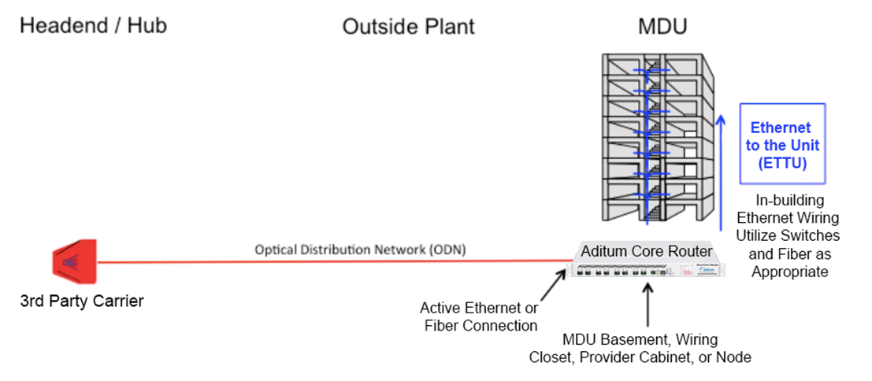
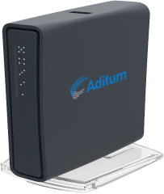
Architectural Overview
Headend
Outside Plant
Inside Building
Fiber Optic Distribution Network
Fiber to the Premise (FTTP)
3rd Party Carrier

Slide 14
PRODUCT FEATURE DEMONSTRATIONS

Slide 15
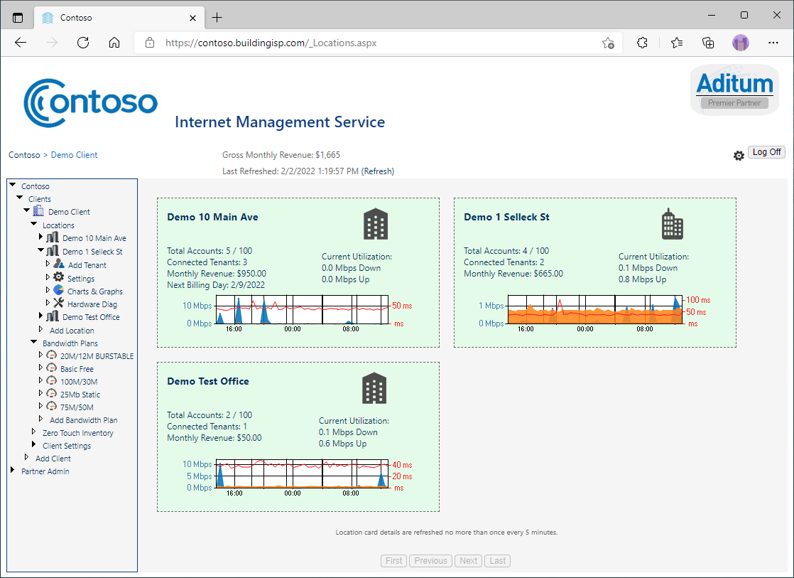
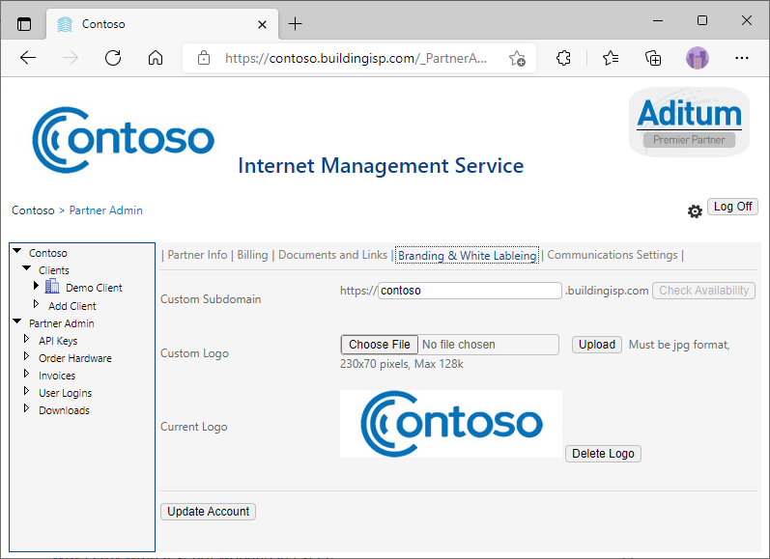
Aditum Allows a Portfolio to be Centrally-Managed from
the Cloud-Hosted Partner Portal, https://ims.buildingisp.com
CENTRALLY MANAGED
The white-label features include ability to customize logo, subdomain branding and email templates.
List of client locations and bandwidth plans.

Slide 16
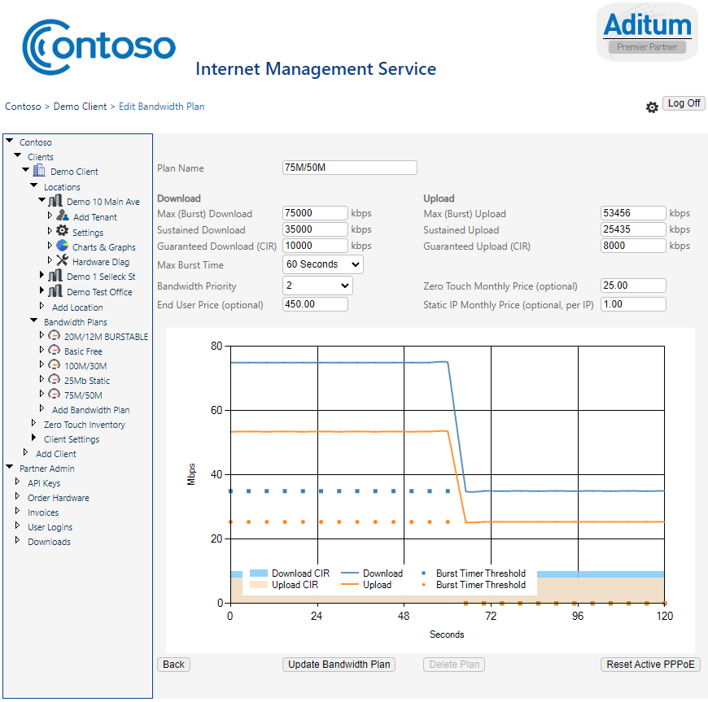
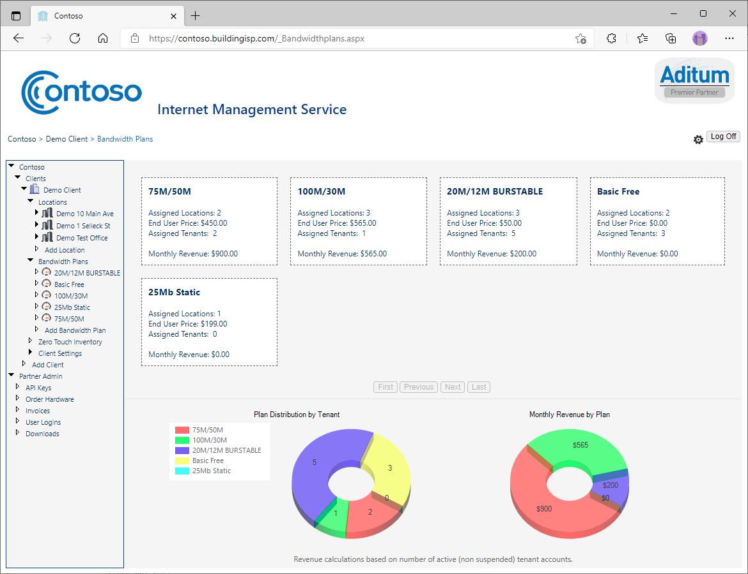
Aditum Allows each Client to Create Custom Bandwidth Plans and Service Offerings
CUSTOM SPEEDS
Enable multiple Bandwidth Plan options per Location for Tenants to choose between.

Slide 17
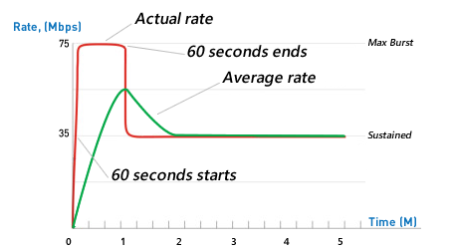
Aditum Delivers a Carrier-Grade Quality of Service with Advanced Bandwidth Shaping and Traffic Prioritization
Example speed profile of long download
ADVANCED QoS
Bandwidth bursting enables circuit over-subscription while providing a consistent level of quality, and cost effective WAN utilization.
Intelligent bandwidth shaping distributes traffic based on plan speed settings, priority, and total available bandwidth on circuit.
Easily prioritize bandwidth plans. Great for mixed commercial/residential environments.
WAN QoS and over-subscription management guarantees minimum tenant bandwidth availability for consistent and reliable service.

Slide 18
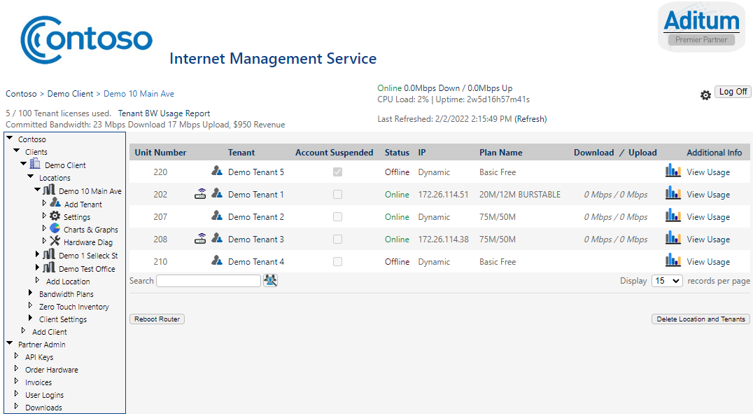
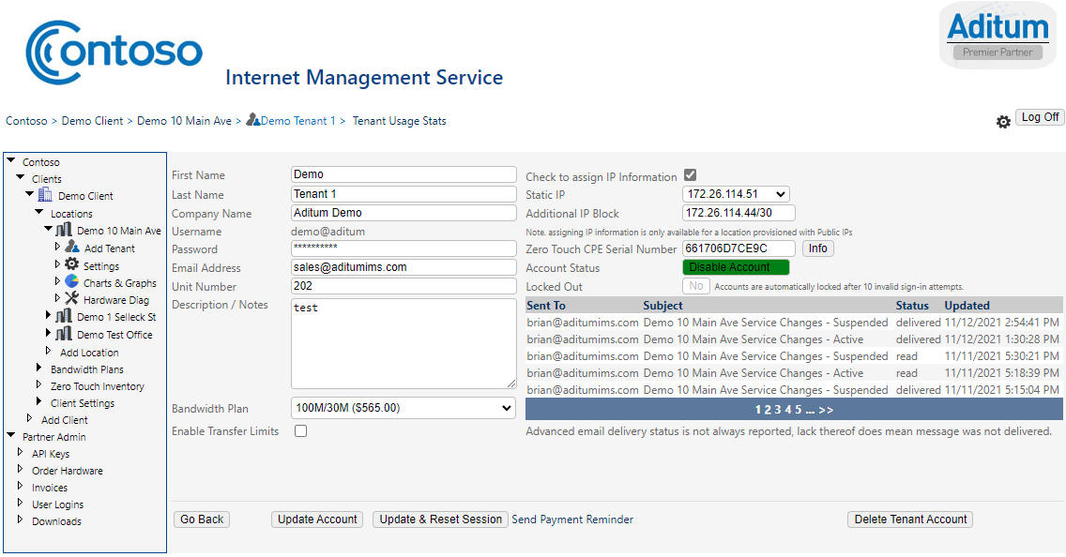
Aditum’s Property Management Software offers Unique Features like, Tenant Account Management as well as Real-Time Status, with a Few Clicks
EASILY MANAGED
Allows adding/updating tenant account details, select bandwidth plan, enable optional transfer limits, enable/disable account, track communications history, and more, with a few clicks.
Tenant list with up-to-the-minute status and details.
Platform can be entirely self-managed by Property Staff once setup, eliminating requirement for support tickets when add/change/delete requests come from Tenants.

Slide 19
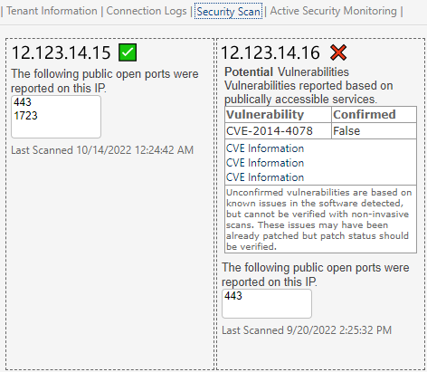
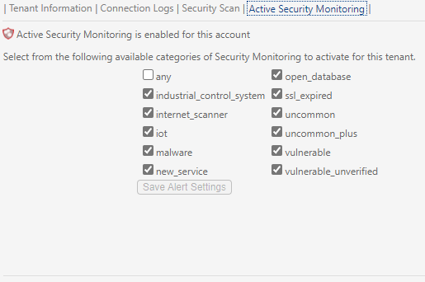
Active Security Monitoring provides tenants with Vulnerability Scanning & Alerts
Add Additional SaaS Revenue to your buildings
Enroll Tenants in regular Security Scanning and Vulnerability Detection to alert them to security issues on their firewall or publicly accessible servers before hackers are able to take advantage of them
SECURITY MONITORING
Perform free security lookups at anytime to see previously detected issues on Tenant firewalls
*Security Monitoring requires Tenant to be assigned Static IPs

Slide 20
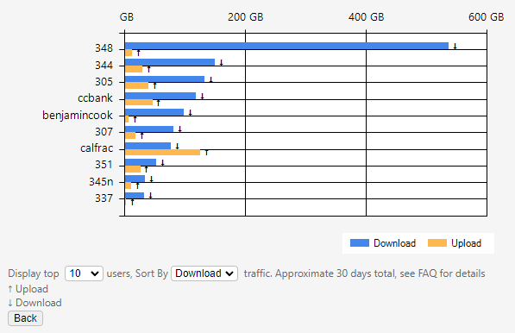
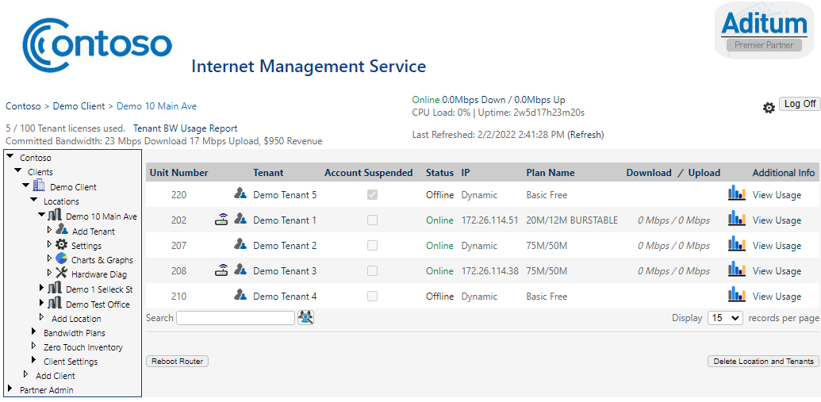
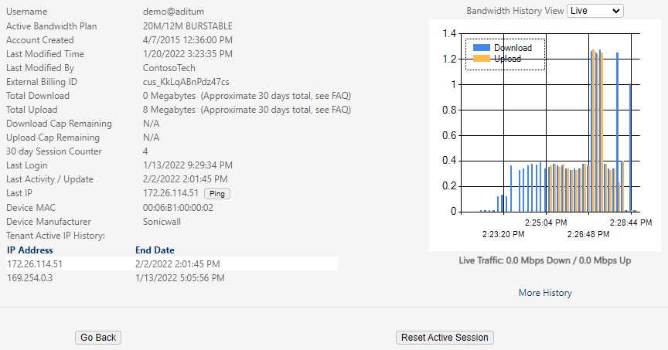
Aditum Permits a Premise Administrator(s) to View Data Utilization Graphs and Statistics
TENANT STATISTICS
Easy access to both historical and real-time utilization charts as well as property wide usage data

Slide 21
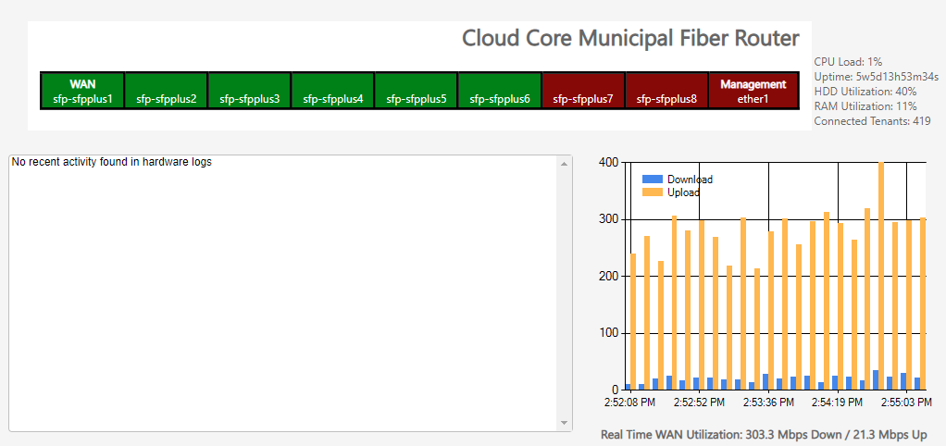
Real Time Diagnostics means simple and fast access to important information
Real Time Hardware Statistics allow instant access to performance information and troubleshooting.
WAN Utilization reporting shows total circuit performance for easy monitoring.
Connection and device logs help identify common connection problems with tenants.
DEVICE DIAGNOSTICS

Slide 22
PRODUCTS

Slide 23
Aditum’s Zero-Touch Router is the Gateway that Allows Premises of Any Size, to Deploy Tenant Broadband Effortlessly
The easiest solution to connect your tenant broadband.
Administrator(s) assigns router to tenant’s account.
Zero Touch router automatically programs itself, assigning unique wireless SSID and password. Plug-in and connect.
Tenant automatically receives customizable welcome letter, along with Wi-Fi information.
ZERO TOUCH
ROUTER
Enables effortless end-user deployments and tenant self installation.

Slide 24
Integrated Direct Tenant Billing
Currently supported with Stripe.com and Invoiced.com. Supports automated generation of monthly invoices for internet service, and billing for Zero Touch Routers, and Static IP assignments.
Automatically suspends service for unpaid accounts, automatically restores service upon successful payments.
Selectable configurations allows suspending internet for any outstanding balance, or just internet.
Billing profiles applied per building, supporting different billing days, suspension rules, and tax rates to be defined per property.
Does not require API license, billed by number of tenants, not by property size.
DIRECT TENANT BILLING
Automating a business's monthly billing processes can be one of the easiest ways to improve employee efficiency, reduce customer complaints, and cut admin costs. Automating and integrating Rent and Internet Service fee collections together is the best way to ensure complete prompt payments from all tenants.

Slide 25
Extend the Aditum platform into 3rd party platforms through API Access
Example API query result for Tenant details
Add and tenant Internet Service controls to your tenant management platforms though API integration.
Enable Self Service Capabilities within 3rd party Tenant Experience apps allowing Tenants to select and upgrade their internet service packages directly from the same application they already use to submit requests like maintenance tickets.
Enable changing subscribed internet connection speeds and retrieve WiFi information from directly inside your existing tenant communications and access platform.
{
"TenantID": "83b61db0-81f2-447f-acdb-73427c2dfe6e",
"ClientID": "039f7013-376c-41bc-fa29-13e62d5d3cb1",
"ClientName": "Demo Client",
"LocationID": "1b4084af-31c8-ab8c-9320-704b41a45c2f",
"LocationName": "Demo 10 Main Ave",
"BandwidthPlanID": "a18bba64-32de-4014-a600-290e0fc8d247",
"PlanName": "20M/12M BURSTABLE",
"Username": "demo@aditum",
"FName": "Demo",
"LName": "Tenant 1",
"Notes": “Sample Tenant Account",
"StaticIP": "172.26.114.51",
"EMail": “sales@aditumims.com",
"AdditionalNet": "172.26.114.44/30",
"Suspended": false,
"CreatedDate": "2015-04-07T16:36:00",
"UpdatedDate": "2021-11-11T22:08:40",
"UnitNumber": "202”,
"CompanyName": "",
"SerialNumber": "651706C7CA9B",
"ssid": "WiFiNet-B7DD3C",
"wpapass": "04Rm543eG"
}
EXTENDABLE API

Slide 26
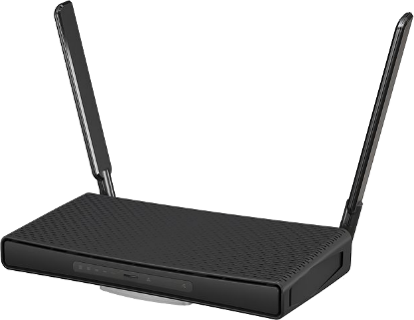
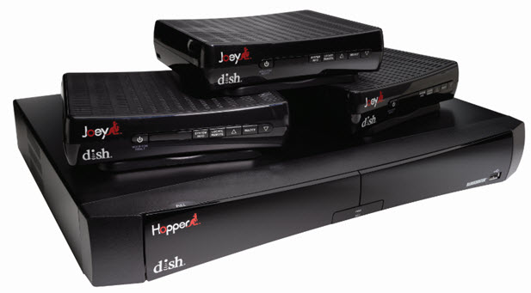
Digital SWM (Single Wire Multi-Switch) Broadcast IP TV delivery
Deliver digital broadcast IP TV to set top cable boxes and DVRs carried over a single ethernet connection to the tenant space.
Only one wire needs ran into each tenant space, Supported set top boxes & DVRs connect directly to the Zero Touch Router via CAT6 to a LAN port on the router.
Eliminates need for dedicated / separate wiring and switch VLAN configurations for internet and TV service for simplified switch configurations lower cost deployments.
Currently certified by and supported with Network’s IP TV platform
BROADCAST TV INTEGRATION
Zero Touch AC³ Router
Compatible Dish Set Top DVR and cable boxes plug directly into the Zero Touch router
Utilizing SWM deployment for a single shared infrastructure is the easiest and lowest cost method to provide bundled TV and internet service to residents.

Slide 27
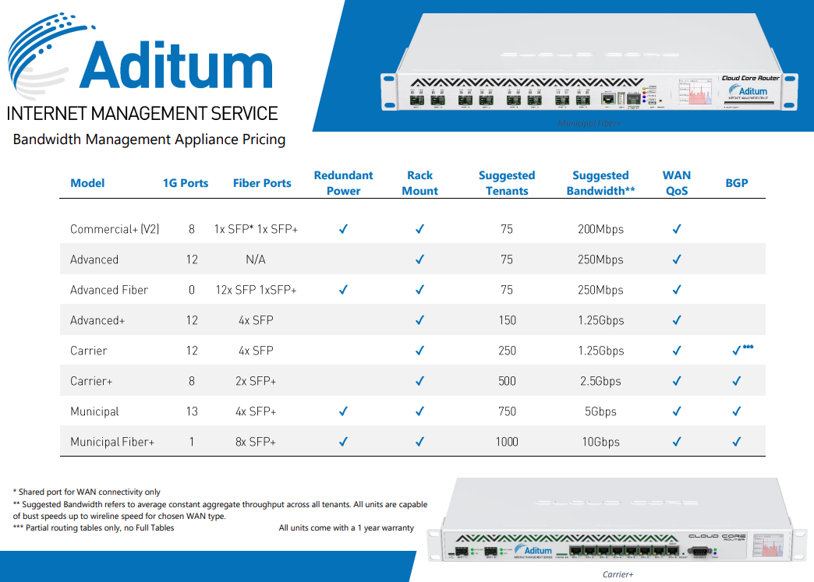
Aditum Hardware and Service Plan Options
Plan Name | Number of Tenants | Bandwidth Policies
Basic | 1-10 | 1
Small | 1-15 | 2
Medium | 10-25 | 3
Large | 25-50 | 4
Small Commercial | 50-100 | 8
Large Commercial | 100-250 | 15
Enterprise | 250-500 | 20
Large Enterprise | 500-1000 | 25
HARDWARE AND PLANS
Hardware Options
Choose service plan by number of tenants and/or number of bandwidth policies needed.

Slide 28
ADITUM HISTORY

Slide 29
ADITUM HISTORY TIMELINE
2005- 2009
2014
2015
2016
2017
2018
2019
An avid computer geek and serial entrepreneur, Brian Higgins co-founds ForePoint Networks with three colleagues, serving as Vice President & Senior Network Engineer. Together, they deliver reliable, secure, affordable rural high-speed Internet to customers becoming Indiana’s fastest growing fixed wireless broadband provider. The company draws the attention of Indiana-based Omnicity Corporation, which acquires the business, network infrastructure and subscribers in 2009 to deliver high-speed Internet access to rural subscribers more cost-effectively.
Understanding the limitations of fixed wireless Internet, Higgins is inspired to design a fiber-based connectivity platform to increase broadband service choice for the commercial real estate industry that provides infrastructure, high-speed broadband connections and is affordable, to close the “digital divide.”
Norwalk, Connecticut-based company, Aditum officially begins development with founder & CEO, Brian Higgins, at the helm. Naming his company Aditum, which in Latin means, to control access, a nod to revolutionizing how the real estate industry connects to the Internet.
Aditum’s broadband platform starts to garner acclaim and is installed in its first building, in the Western United States.
The commercial real estate industry begins to leverage Aditum’s network software platform to accelerate the installation of competitive, high-quality multi-tenant Internet access , capable of achieving speeds of up to 10 Gigabits of broadband service to a building and speeds up to 1 Gigabit are possible to individual tenants – while increasing Net Operating Income (NOI) to the property.
Aditum moves from a private data center to Microsoft’s Azure Cloud and adds infrastructure geo-redundancy service.
Seeking to remedy a common challenge in MDU management, configuring and supporting the tenant router, Aditum introduces the Zero Touch system that intelligently auto-configures the MDU/small business router that starts when plugged into the Aditum system. The Zero Touch commercial-grade routers are available to MSPs, VARs, satellite dealers, property management, and property owners.
Growing in popularity, with installations from coast to coast, Aditum’s developers continue to enhance Aditum’s operating system to help drive the continual quality improvements needed to keep operations competitive.
While Aditum made tremendous inroads in the commercial real estate community since its inception; it continues to dominate its space. The company becomes a firm favorite with key commercial real estate enterprises as a result of product versatility and marketing.
2020
& BEYOND
Aditum, innovator of commercial real estate (CRE) fiber-to-the-premise broadband platform introduces new software updates and Zero-Touch models to add additional features, performance and options to residence and business customers’ premises without breaking the bank.

Slide 30
BUILDING BROADBAND INFRASTRUCTURE, ONE BUILDING AT A TIME
QUESTIONS?
Contact us today or learn more at AditumIMS.com Sales@AditumIMS.com | +1.203.842.8520
83 East Ave, Suite 104, Norwalk, CT 06851

